Slide 1

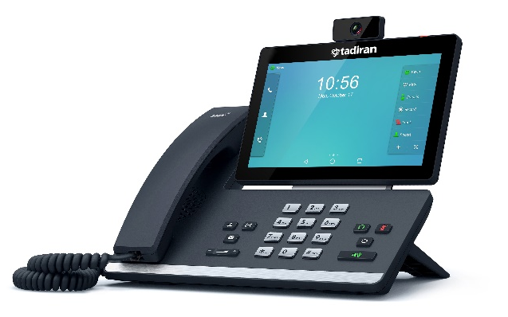

Tadiran T58V
Smart SIP Media Phone
The Tadiran T58V SIP Video Phone is a simple to use, smart media phone that provides an enriched HD audio and video calling experience for business professionals. Based on Android 5.1.1 operating system, the T58V features a seven inch adjustable multi point touch screen, a removable two megapixel HD camera, integrated WiFi and Bluetooth and more. The Tadiran T58V strikes an exquisite balance between simplicity and sophistication, offering an all in one communications solutions for today’s busy executives, managers and teleworkers.
Highlights:
7 inch (1024 x 600) adjustable touch screen
720p30 HD Video
Runs Android 5.1.1
Dual Port Gigabit Ethernet with PoE
Built in WiFi (802.11b/g/n)
Up to 3-party video conferencing
Up to 5-party video/audio mixed conference
Up to 3 Color Screen Expansion Modules
Support of Aeonix automatic provisioning
Phone Features:
Call hold, forward, mute, DND, transfer
Call recording, hotline, one touch dial
Redial, call waiting, emergency call
Data import/export via Bluetooth
Ring tone selection/import/delete
Volume adjustment
Directory:
Local phonebook up to 1000 entries
XML/LDAP remote phonebook
Intelligent search method
Phonebook search/import/export
Call history
Black list
IP-PBX Features
Intercom, multicast paging
Anonymous call, anonymous call rejection
Voice mail, distinctive ringtone, call pickup
Message Waiting Indicator
Audio and Video Features:
HD voice, HD Handset, HD Speaker
Audio Codec: Opus, G.722, G.722.1, G.722.1C, G.711, G.723, G.726, G.729AB, iLBC
Video Coded: H.264 High Profile, H.264, VP8
Self View (local video preview)
Feature Keys:
27 one-touch DSS keys
8 feature keys: hold, transfer, message, headset, mute, redial, speakerphone, volume
Illuminated mute/headset/handsfree speakerphone key

Slide 2

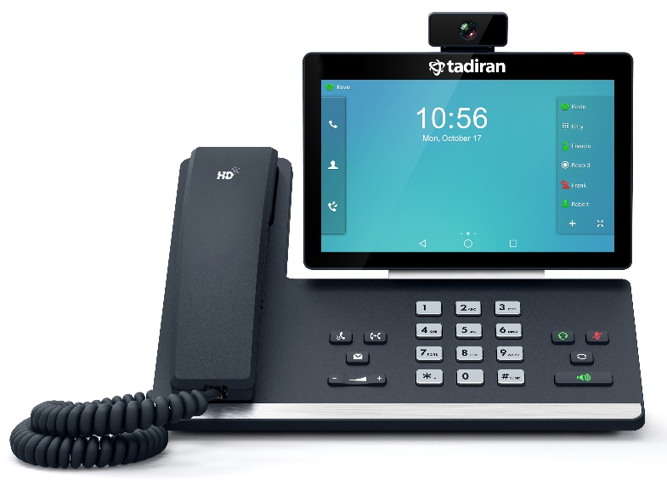

Interface:
Dual port Gigabit Ethernet
Power over Ethernet (IEEE 802.3af ), class 3
Built in WiFi (2.4 GHz, 802.11 b/g/n)
Built in Bluetooth 4.0 + EDR for headsets and pairing mobile devices
1 x USB 2.0 port for Camera
1 x USB 2.0 port for USB and expansion
1 x Security Lock Port
Network and Security:
SIP v1 (RFC2543), v2 (RFC3261)
Call server redundancy supported
IPv4/IPv6
NAT transverse: STUN mode
Proxy mode and peer-to-peer SIP link mode
IP assignment: static/DHCP
HTTP/HTTPS web server
Time and date synchronization using SNTP
UDP/TCP/DNS-SRV(RFC 3263)
QoS: 802.1p/Q tagging (VLAN), Layer 3 ToS, DSCP
SRTP for voice encryption
Transport Layer Security (TLS)
HTTPS certificate manager
AES encryption for configuration file
Digest authentication using MD5/MD5-sess
OpenVPN, IEEE802.1X
Management:
Configuration: browser/phone/auto-provision
Auto provision via FTP/TFTP/HTTP/HTTPS for mass deploy
Auto-provision with PnP, Zero-sp-touch, TR-069, SNMP
Reset to factory, reboot
Package tracing export, system log
Setup assistant wizard
Other physical features:
Wall Mountable
External power adaptor: AC 100 ~ 240V input and DC 5V/2A Output
Power Consumption (PoE): 2.6w - 7.4w
Power Consumption (PSU): 1.9w – 5.7w
Dimension(W*D*H*T):
259.4mm*220mm*239mm*42.6mm
Operating humidity: 10~95%
Storage temperature: -10~40°C
About Tadiran:
Tadiran Telecom (TTL) L.P. is a privately held partnership, owned by Afcon Holdings Ltd. and part of the Shlomo Group. It is an established global provider of Unified Communications & Collaboration (UC&C), Contact Center, and Control Room solutions, serving businesses of all sizes, including tier-1 organizations in various market segments in 41 countries worldwide. Tadiran solutions feature a comprehensive family of products including UC platforms, soft switches, contact centers, Dispatch Console, IP phones and mobility and desktop solutions.
Visit us at: www.tadirantele.com
Copyright © 2023 Tadiran Telecom (TTL) L.P. Specifications subject to change without notice. All other products or services mentioned are the trademarks, service marks, registered trademarks or registered service marks of their respective owners.
Israel +972-3-9262000 China +86-10-58696418
USA +1-678-506-7200 India +91-11-41523168/23353822

